Slide 1

US AIR POLLUTION ANALYSIS
Group : Meaningful Patterns
DSC 465 : Data Visualization

Slide 2
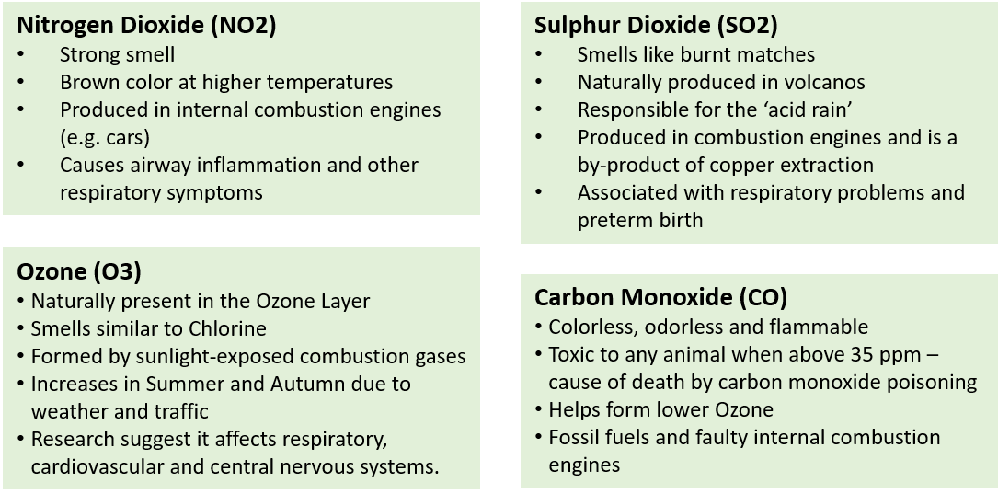
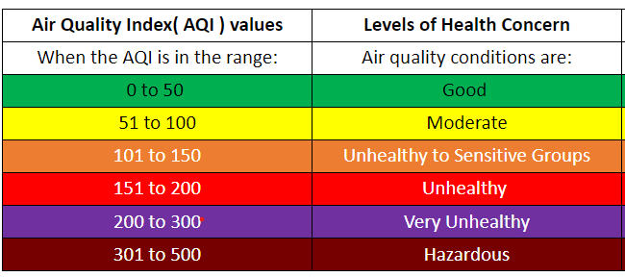
Introduction to the Data
Air Pollution in the USA :
Year Range - 2000-2016
4 major pollutants
47 States
133 Counties
144 Cities
28-Variables , 1.7M records
Categorical & Geographical :
Pollutant Units, State , County, City
Continuous : Day, Month, Year AQI (for all gases) Mean value Max_hour Max_value

Slide 3
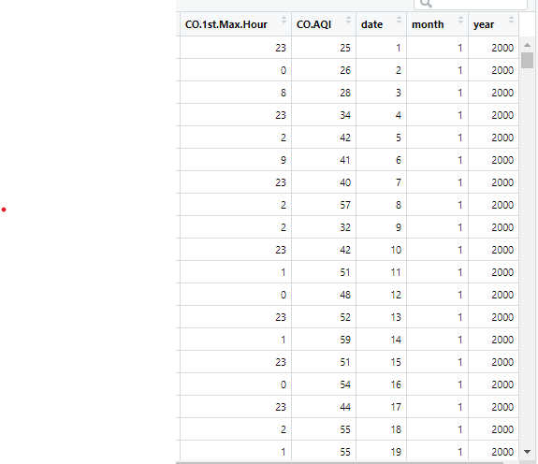
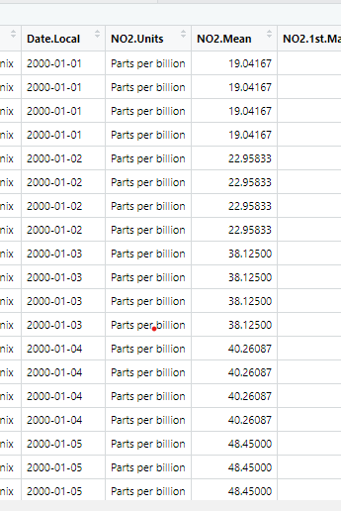
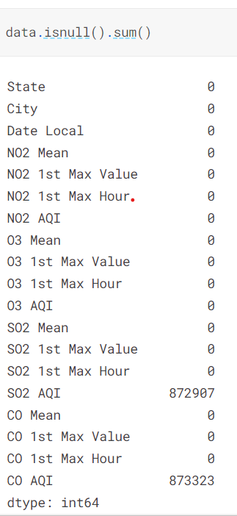
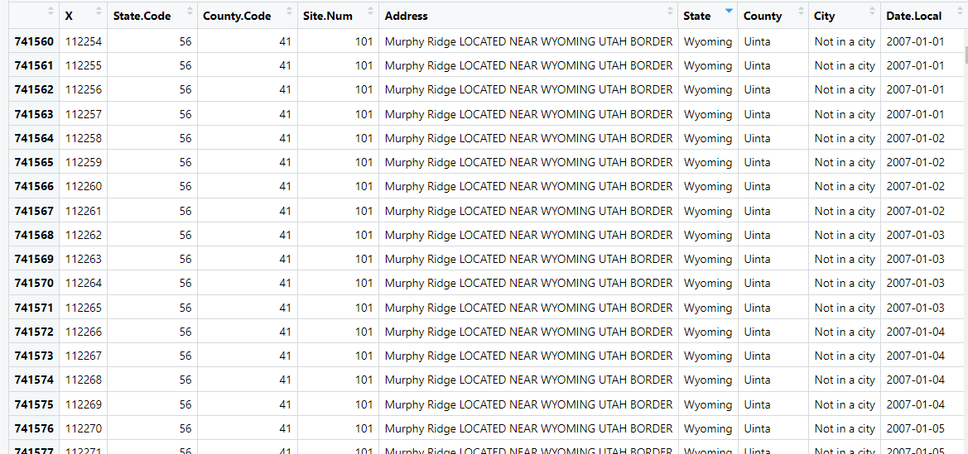
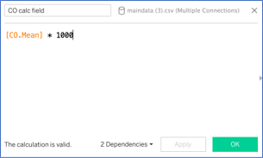
Data Pre-processing
Unnecessary variables - removed
Checked for Null values - removed
Separated the date column into date, month and year
Removed Units Column
Converted PPM-PPB
Pre-processed data exported
Used to generate visualizations in R Studio and Tableau.

Slide 4
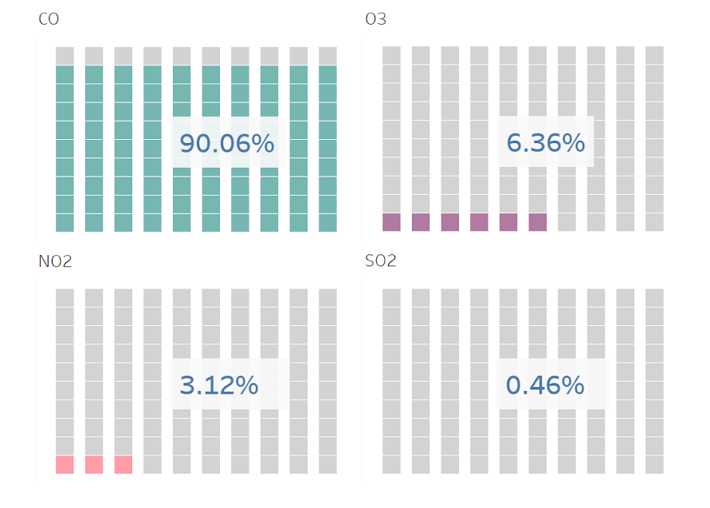
Average Gas Concentration in the Atmosphere
Waffle Plot depicts the total concentration of each gas.
Units – Parts Per Billion
Largest portion of the atmosphere comprises of CO.
Each gas damages the environment in different ways.
Higher concentration doesn't mean higher damage.​

Slide 5
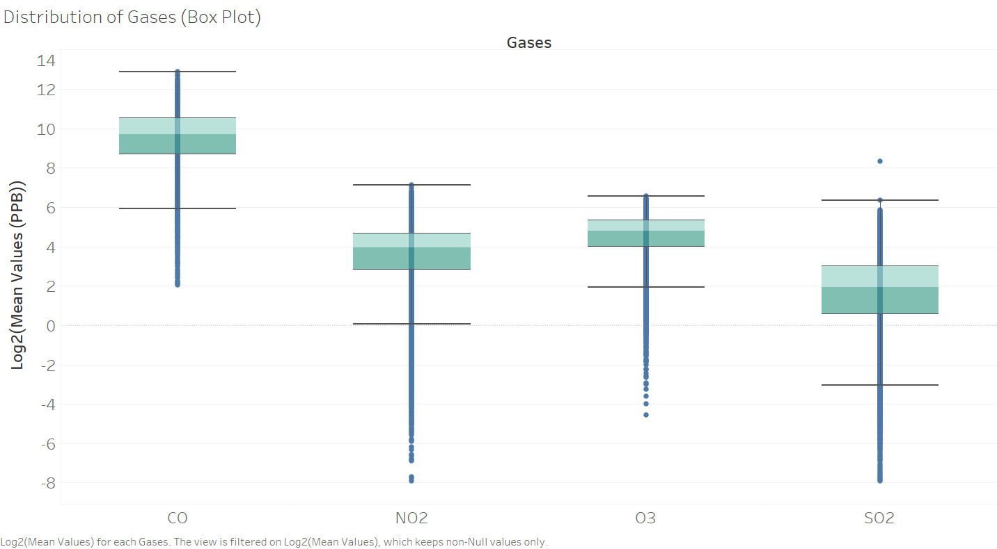
Distribution of Gases – Outlier Analysis
Box Plot : concentration of values and the outliers.
Shows longer tail on lower of values. ​
Average value for those gases might be low, but that's not the case.​

Slide 6
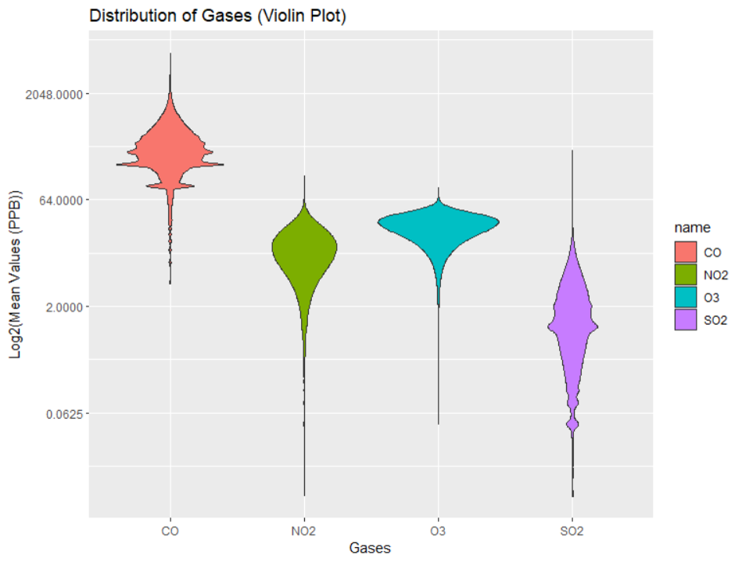
Distribution of Gases
Violin Plot is used to show the distribution of gases.
Except for SO2, most of the gases are in fact concentrated in the upper range.​
SO2 has the largest distribution?​

Slide 7
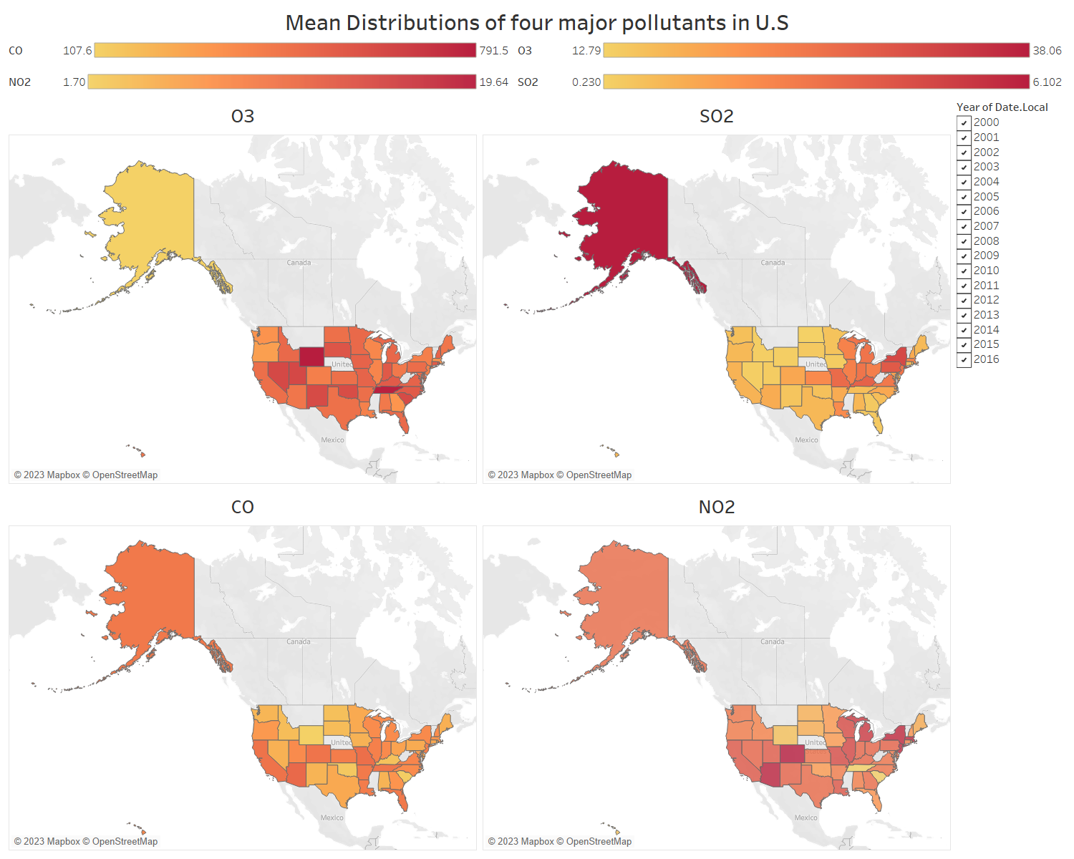
Mean Distribution of all the four Pollutants
This Choropleth dashboard depicts the average distribution of the pollutants across all states in the US over the past 15 years.
Mean distribution of CO is high compared to other gases in the US.​
Mean distribution of SO2 is low compared to other gases in the US. ​
Let’s look at the distribution of the pollutants in Alaska.
Wait!!! Other states are too tiny!

Slide 8
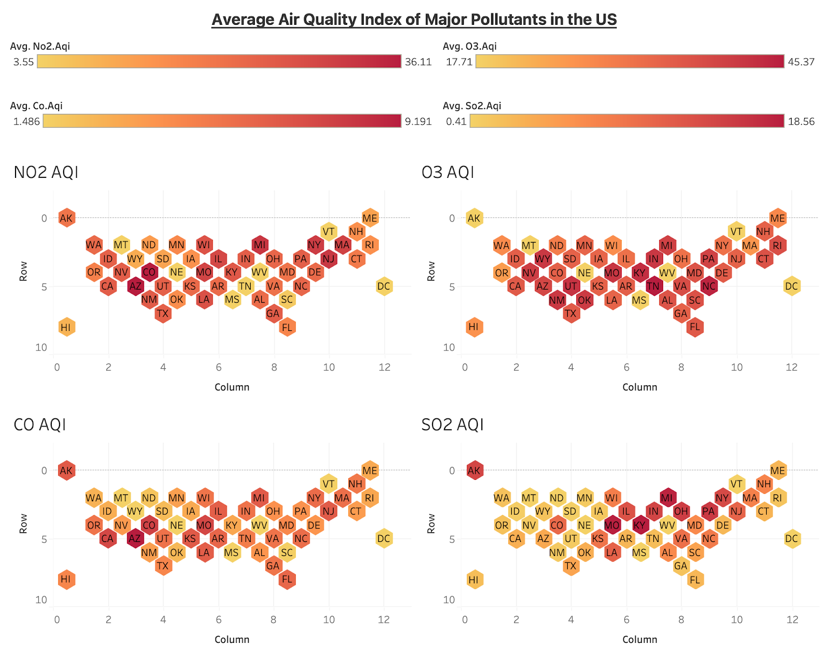
Average Air Quality Index of all the four Pollutants
This Hex tile cartogram depicts the average AQI of the pollutants in the US.
Better Comparison
The states are uniformly sized
States with major metropolitan cities - higher AQI values
Average AQI values of O3 and NO2 has reached concerning level over the past years.

Slide 9
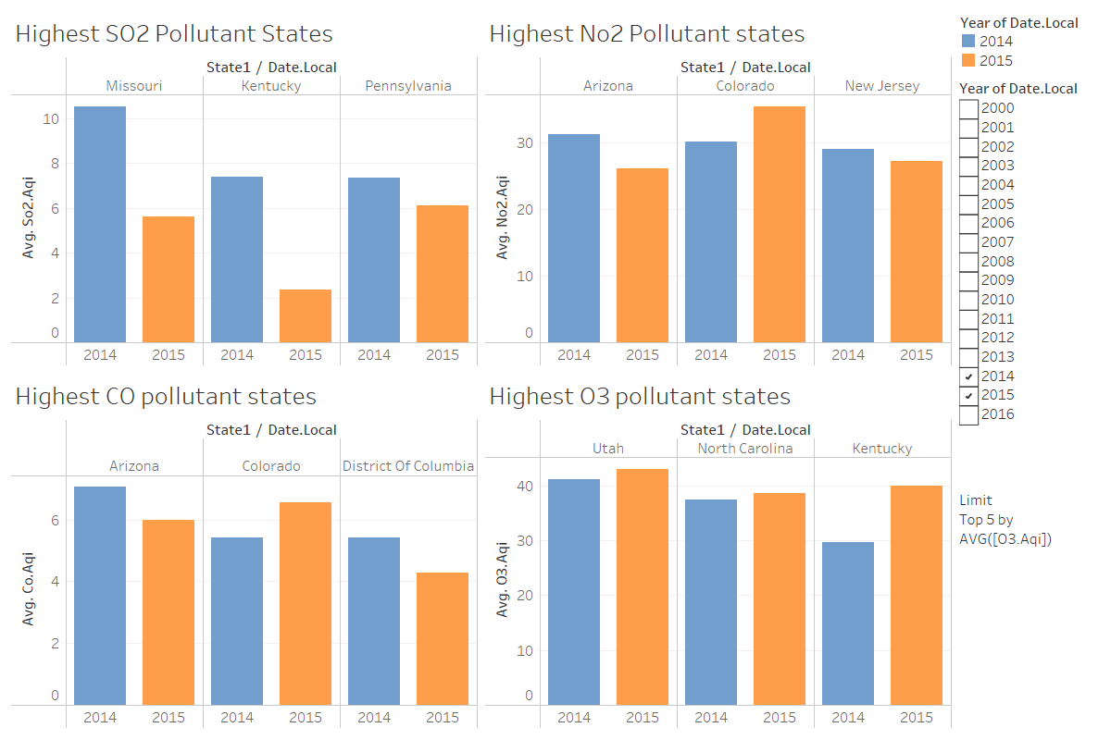
Comparison of highest pollutant states for 2014 &2015
Side-by-Side Bar graph Dashboard-4 comparison analysis.
Comparison analysis of AQI for 2 consecutive years ( 2014 & 2015).
Ozone Analysis:
Utah , North Carolina, Kentucky
Sulphurdioxide Analysis:
Missouri , Kentucky, Pennsylvania
Nitrogendioxide Analysis:
Arizona , Colorado , New Jersey
Carbon monoxide Analysis:
Arizona, Colorado,
District of Columbia

Slide 10
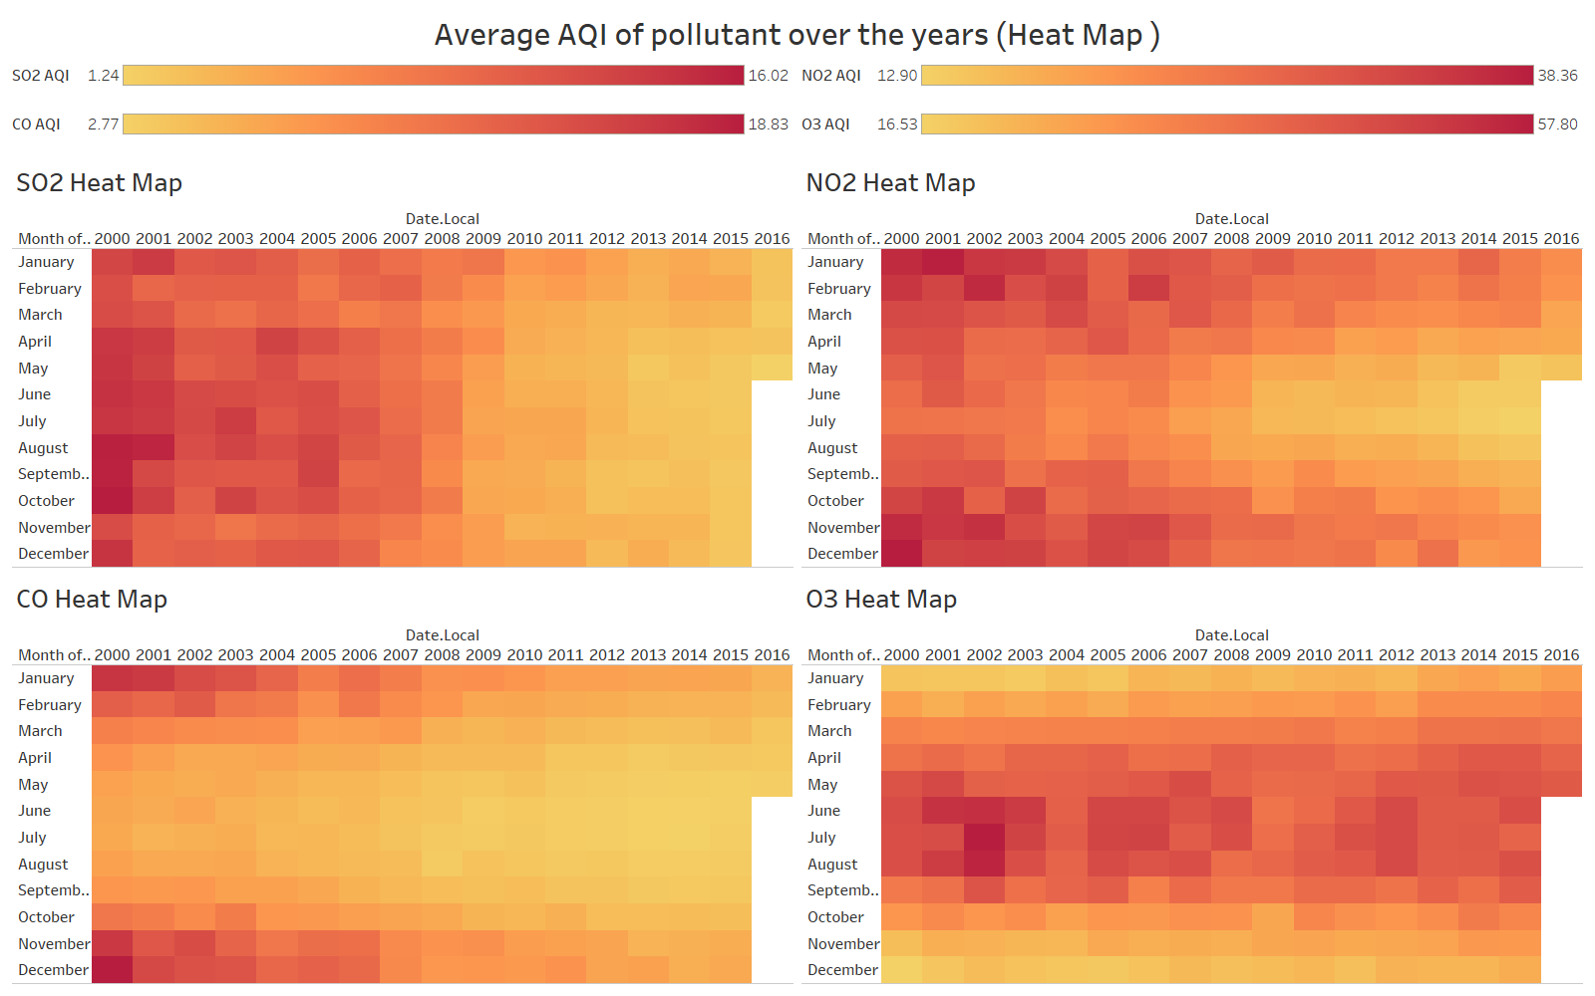
Average Air Quality Index of all the four Pollutants- Over the years
Interactive visualization -Time Series Dashboard.
Average AQI for each pollutant- whole timestamp of the data- detailed analysis for all the months.
Sulphur dioxide &nitrogen dioxide: August
Nitrogen Dioxide: October - February.
Carbon Monoxide: November - January.
Ozone: negligible improvement

Slide 11
CONCLUSION
CO, one of the greenhouse gas, has the highest concentration in the atmosphere.
NO2 and O3 affects the AQI index more compared to other gases.
SO2 even though has low overall concentration in the atmosphere, it affects the atmosphere in the most severe way.
AQI getting better over the years in US.
CO and SO2 decreasing over the years.
O3 is getting higher during summer.
More data is required to get better idea.

Slide 12
THANK YOU

